Slide 1
Zoom AU Community Brunch and Learn
extending Zoom Rooms to manage more sophisticated AV

Slide 2


Intro
Wally Clewett
9 years at University of the Sunshine Coast
Service Desk, IT Support, AV Systems
4 years experience with Zoom
Currently a stay-at-home dad

Slide 3
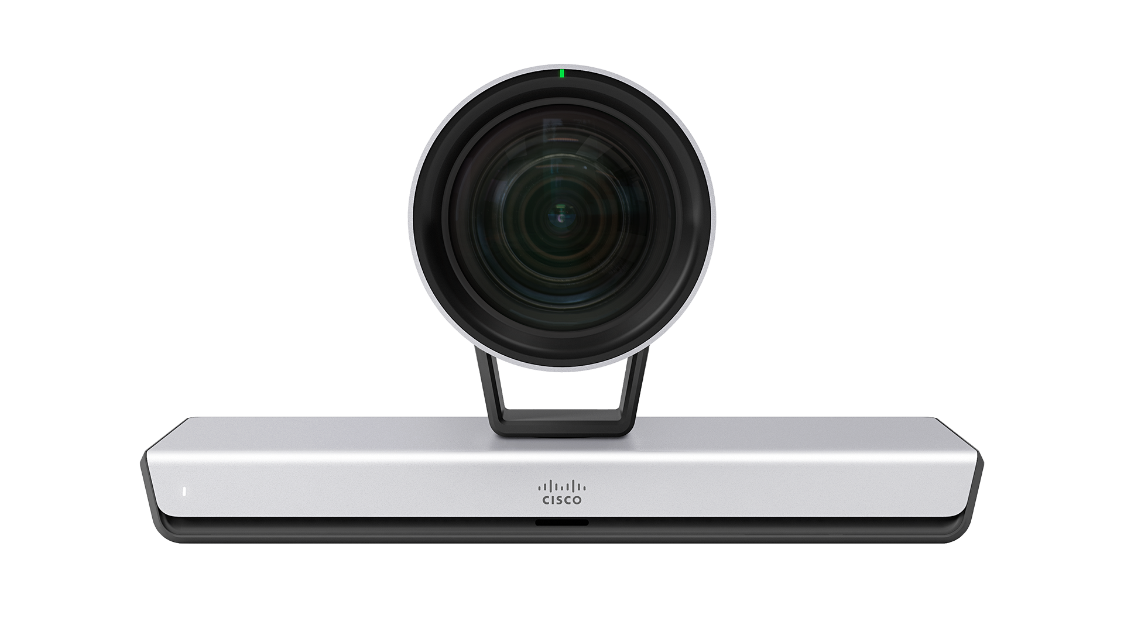
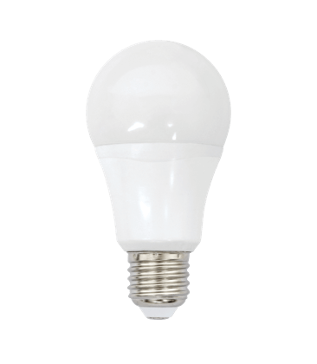
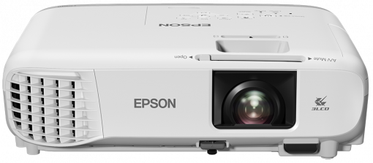
Controlling 3rd Party Devices in Zoom Rooms
Zoom Rooms have been a great solution for simple meeting rooms
Challenges arise when we want to get a little fancy
Turn on/off LCD screens or projectors
PTZ non-USB cameras
Turn on/off lights or activate presets
Third party control required (Creston, QSC)
Difficult to integrate this control seamlessly

Slide 4
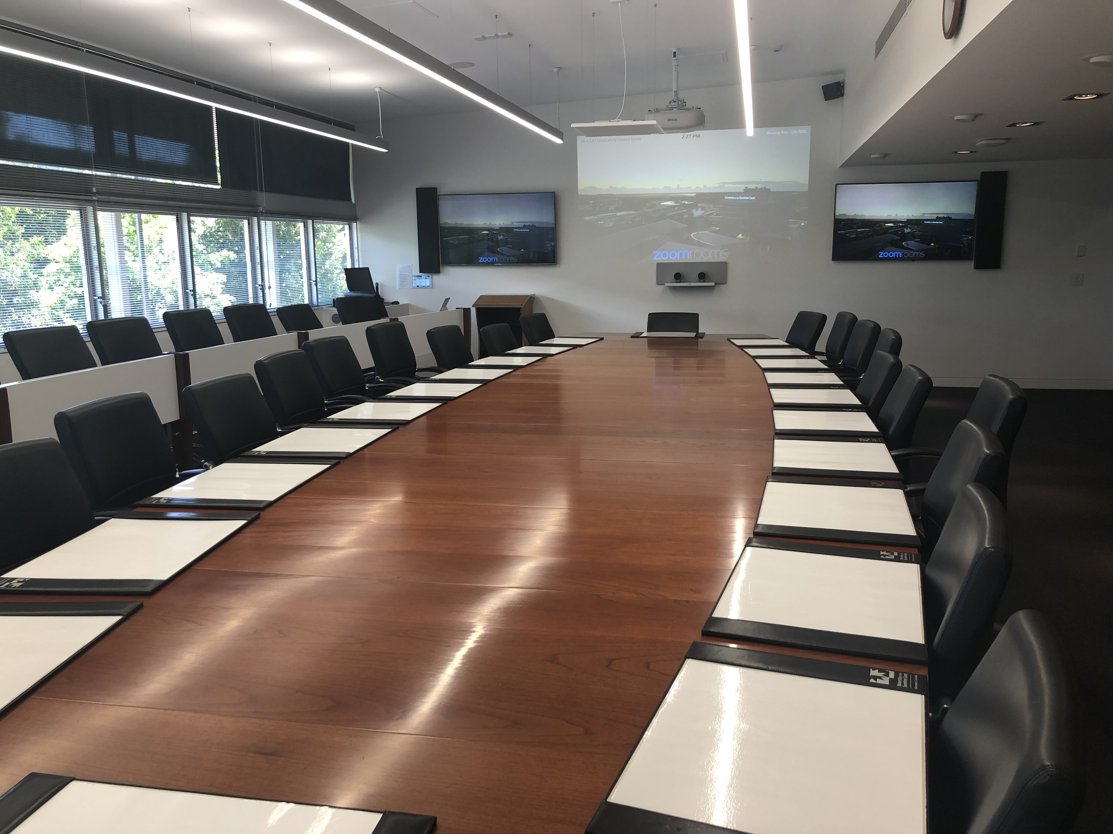
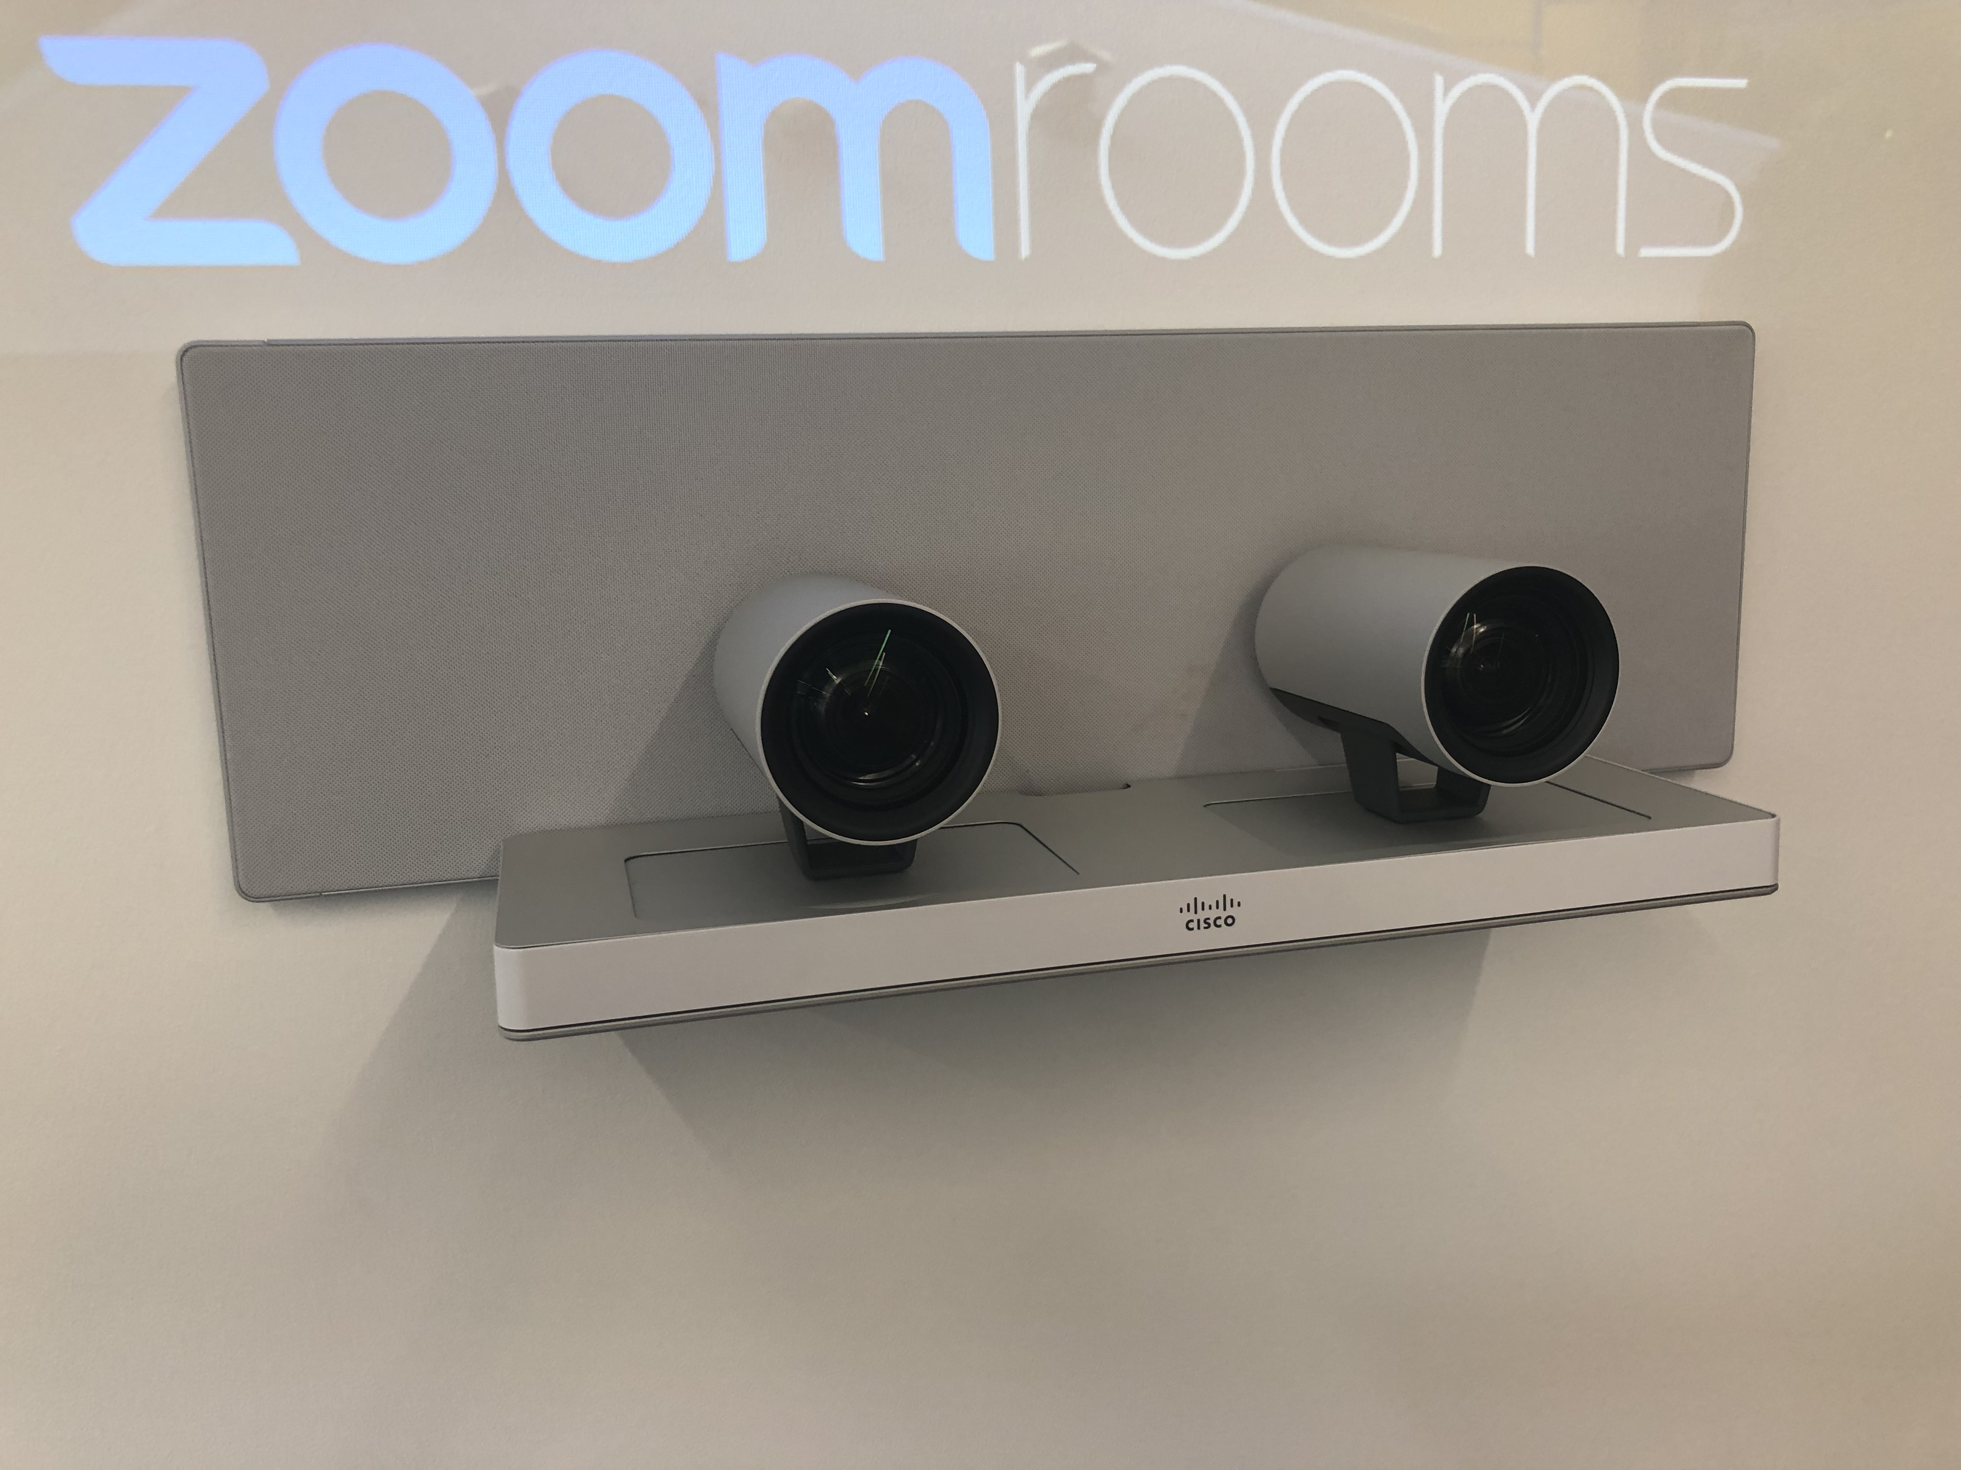
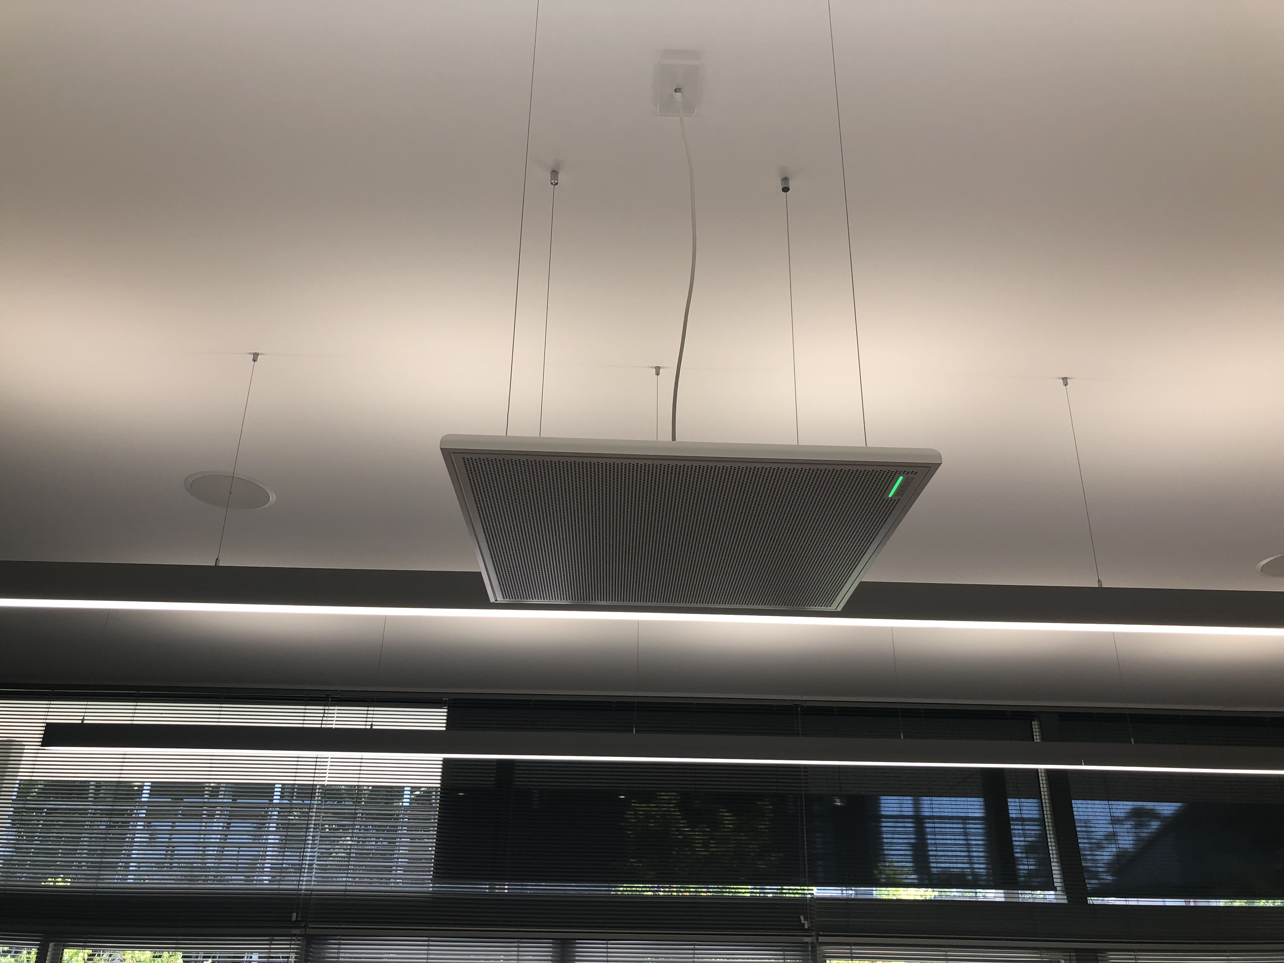
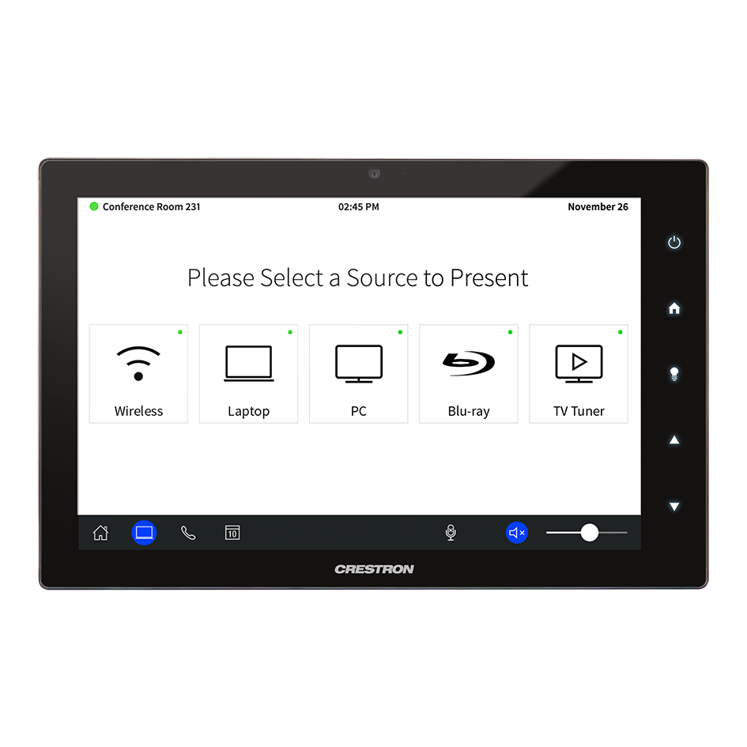
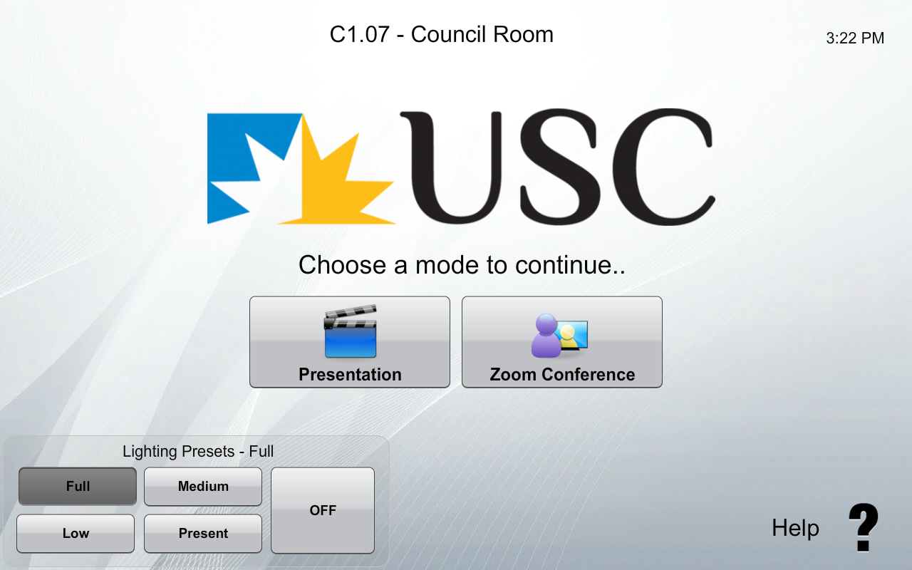
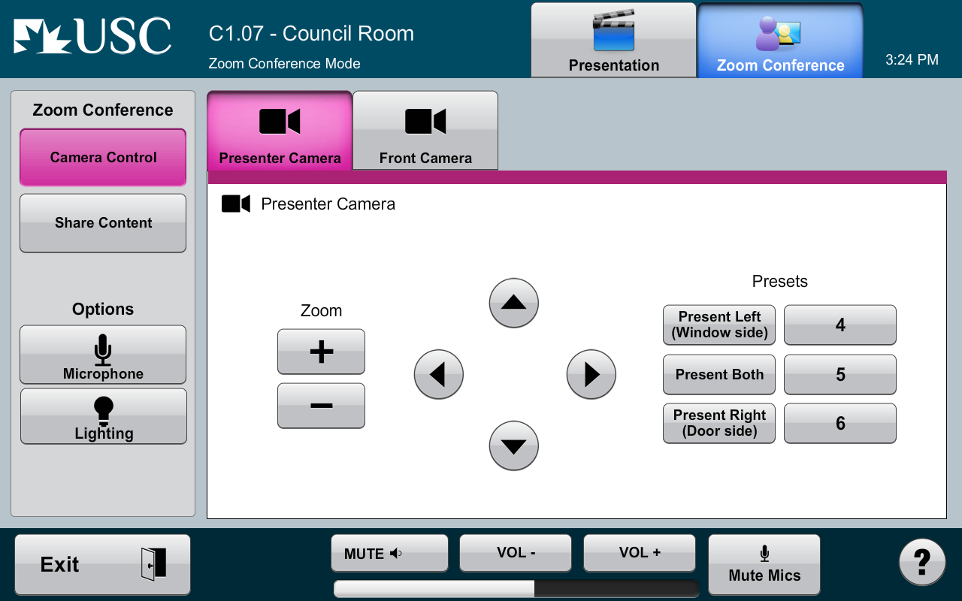
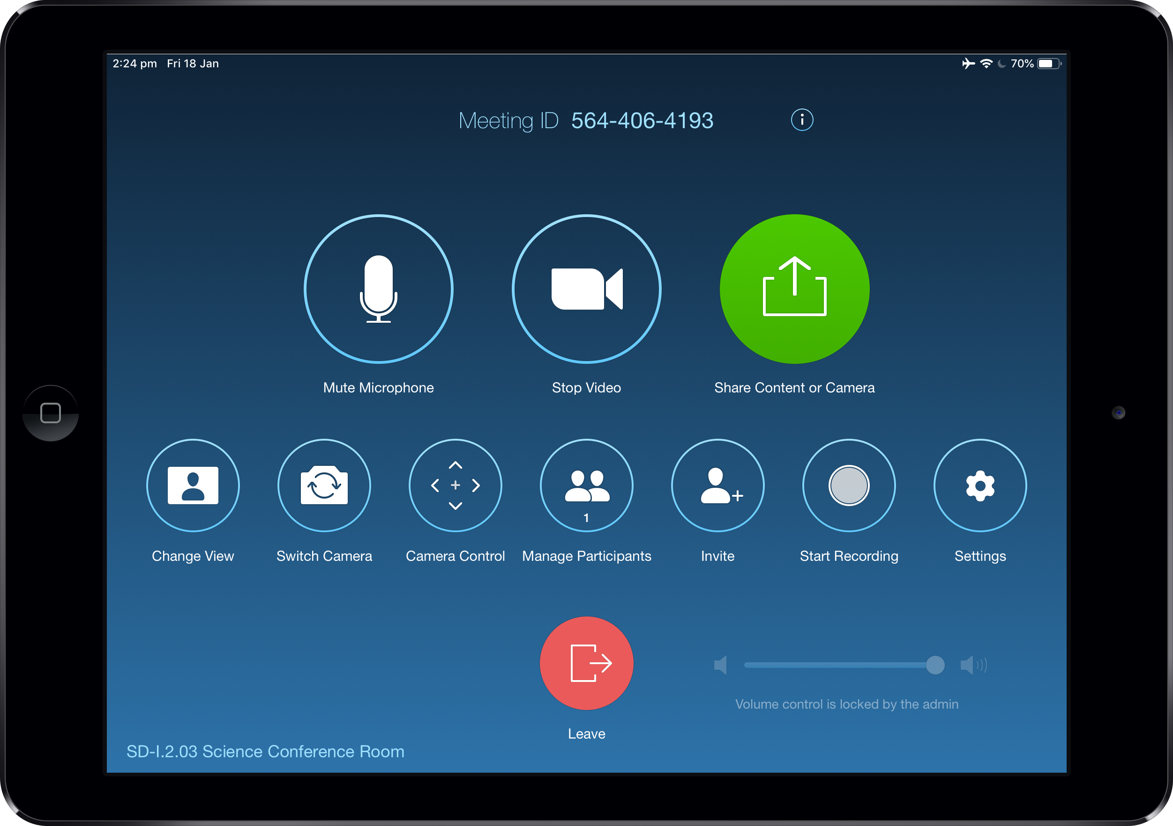
EXECUTIVE Conference Room JANUARY 2018

Slide 5
What did we learn?
The user experience is the most important thing to get right
Keep the controls as simple as possible
Devices which run on battery will run out of battery
Integrating third-party control into a Zoom Room is challenging
Don’t assume your AV integrator knows what they’re doing
Notes:
The user experience is the most important thing to get right!
You can blow your entire budget on the best screens, microphones and cameras money can buy but they’re not going to count for much if the users can’t get the meeting started on time, every time
Confusing user interfaces and inconsistent room designs lead to poor user experiences
Keep the controls as simple as possible
Crestron touch panel to control room (screens, lighting, microphones, cameras, etc)
iPad to control Zoom meeting
House PC to initiate screen sharing
Too many things for the users to learn
We would often find users joining Zoom meetings from the house PC which wasn’t connected to the cameras and microphones
Devices which run on battery will run out of battery
The iPad was the only way to start and interact with the Zoom meeting, so when the iPad had been left off the wireless charger overnight there was no way to start the 9am meeting the next day
Integrating third-party control systems into a Zoom Room is challenging
As we didn’t have an in-house AV programmer we had to go back to the integrator and ask them to implement each change
These changes were disruptive as it meant we had to take the room offline, sometimes for days at a time
Don’t assume your AV integrator knows what they’re doing
We used 3 different AV Integrators at the time and each of them had little to no experience with Zoom Rooms. They were used to installing traditional video conferencing systems with hardware codecs and saw the Zoom Room as just another source to feed into a video switcher. We felt like we knew what we were trying to do but did not have the right tools and support network to do pull it off.

Slide 6
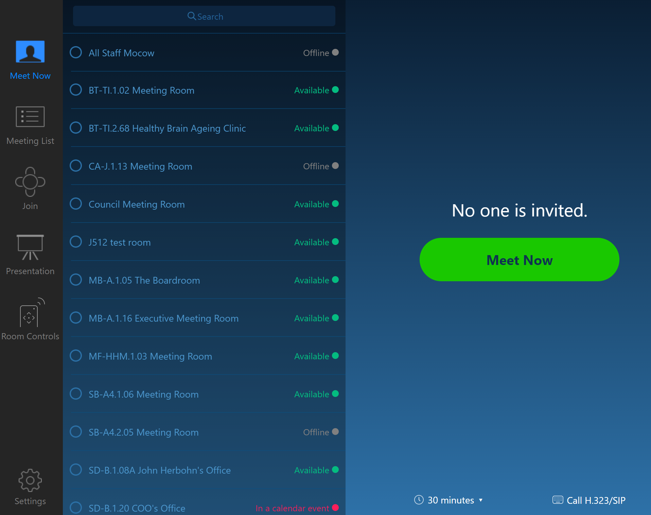
IS THERE a better way?
How can we improve the user experience while still being able to control all the devices in the room?
ZR-CSAPI
Page flip
Still reliant on a third-party controller to do the work
At Zoomtopia 2019, Zoom introduced native room controls
Allow IP-capable equipment to be controlled by the user through the Zoom Room controller
Notes:
ZR-CSAPI
Recreate the wheel and redesign the Zoom Room interface using the Zoom Room API and integrate into our existing Crestron touch panels
Not-evergreen, meaning we could miss out on new features and enhancements
Page Flip
Flip between the Zoom Room native app and our custom app that controls cameras, lights, etc
Clunky and unintuitive
Problem with these options
Still reliant on a third-party controller to do the work
Zoomtopia 2019, Zoom introduced native room controls, allowing third-party, IP-capable equipment to be controlled by the user through the Zoom Room controller
Half-baked, poorly documented, unGoogleable, but it works! So now we have just about everything we need to be able to control all the devices in the room using only the Zoom Room computer.
Zoomtopia 2020, Zoom expanded on the existing native controls and improved the documentation

Slide 7
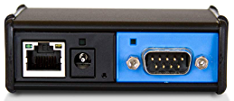
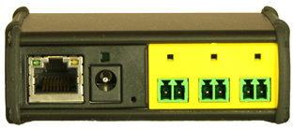
PREREQUISITES
Zoom Rooms version 5.1 or higher
Compatible devices controllable on the network
iTach IP2SL or IP2CC if the device does not have native LAN access
Make sure the Zoom Room is on the same network as the devices you want to control
Read the documentation
Notes:
1) Global Cache IP2SL: this endpoint has a single serial port connection for RS232 control of a single device
2) Global Cache IP2CC: this endpoint has three contact closure ports for control of up to three individual relays
Consider isolating your AV network with a local network switch and a USB to ethernet converter to allow the Zoom Rooms to be on both local and building networks.
Sample file not essential but will make your life 1000x easier

Slide 8
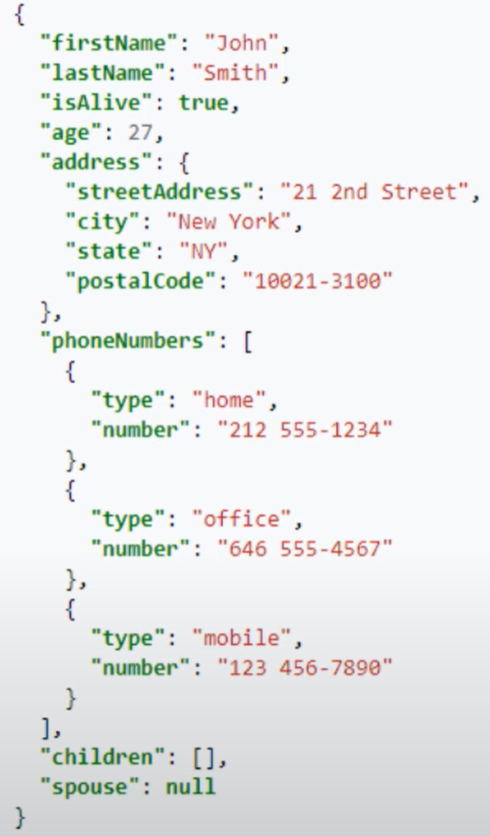
Configuration Profile (JSON)
JavaScript Object Notation
Syntax for storing and exchanging data
Lightweight, easy to read and write
Syntax is very important so use a code editor
Zoom Room Configuration Profiles have 3 main sections
Adapters
Styles
Rules
Notes:
Walk through the basics of a JSON configuration profile.
Think of it like a configuration file rather than programming

Slide 9
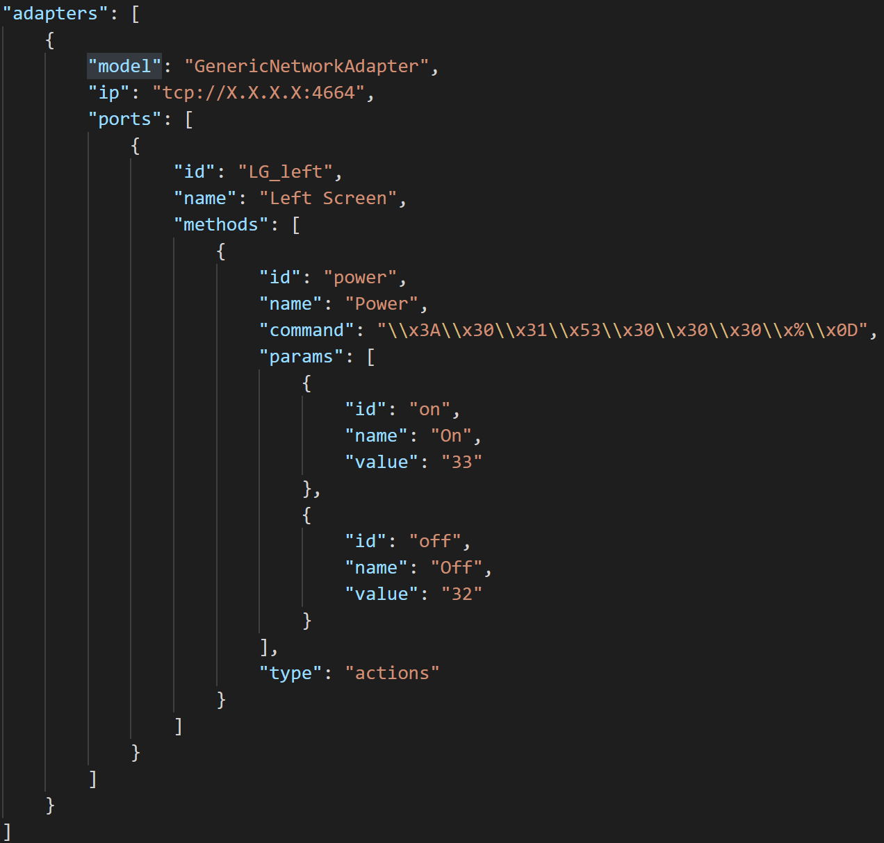
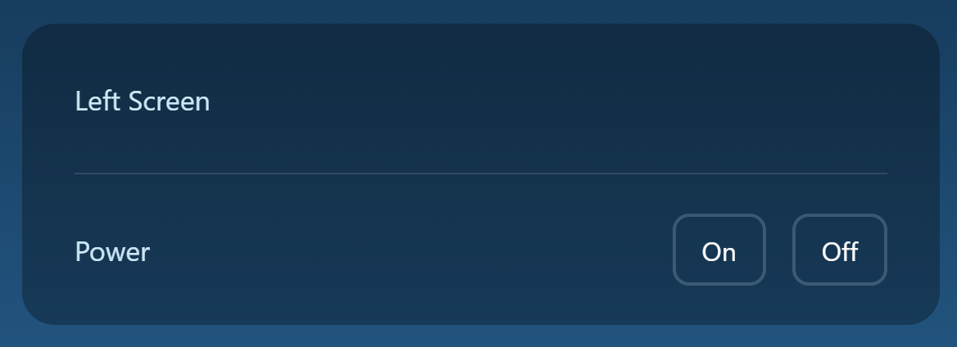
Adapters
Adapters define the connections to your network devices
IP addresses and ports used to connect to device
ID’s and friendly names of device
ID’s, friendly names and commands to control the device

Slide 10
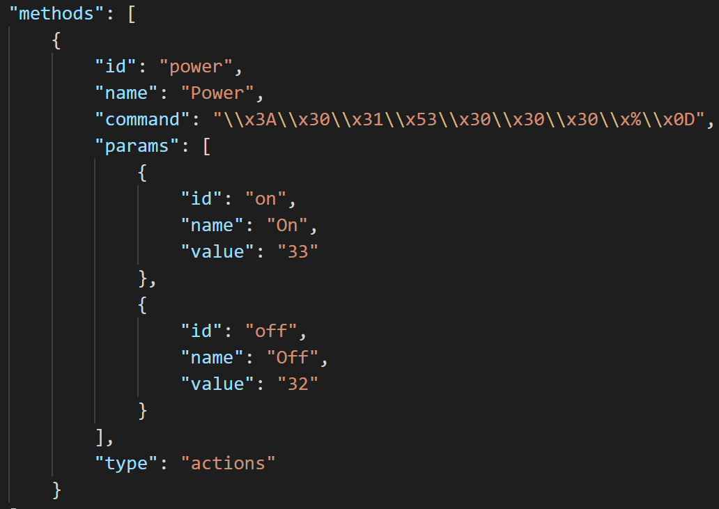
Commands
Commands are instructions that when executed on the device will perform a specific action
Power on TV
Change source to HDMI 1
Mute ceiling microphone
Recall a lighting preset
Different for each manufacturer
Usually documented in the device's manual
Notes:
Commands are simple instructions that when executed on the device will perform that specific action
Different for each manufacturer
Sometimes different for each model
Other examples of commands
Change source to HDMI 2 or DisplayPort1
Mute or unmute a ceiling mic
Recall a lighting preset

Slide 11
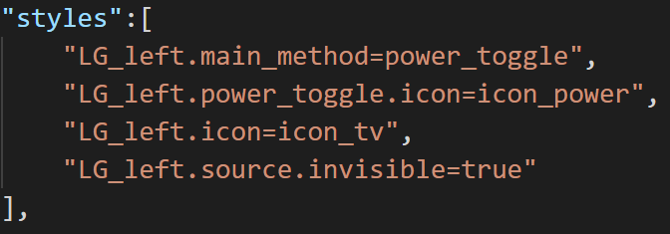




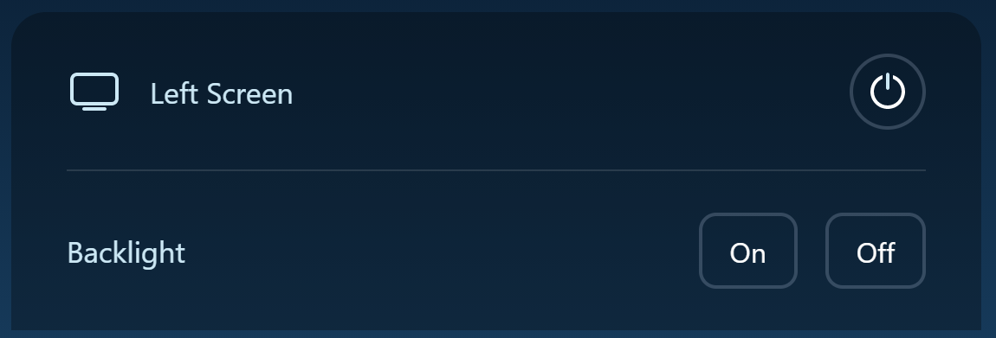
STYLES
Styles allow you to control the visual styling of your interface
Add icons to devices and for the functions of that device
Define a main method to show a prominent action for the device, usually it’s primary function
Hide buttons from the user interface

Slide 12
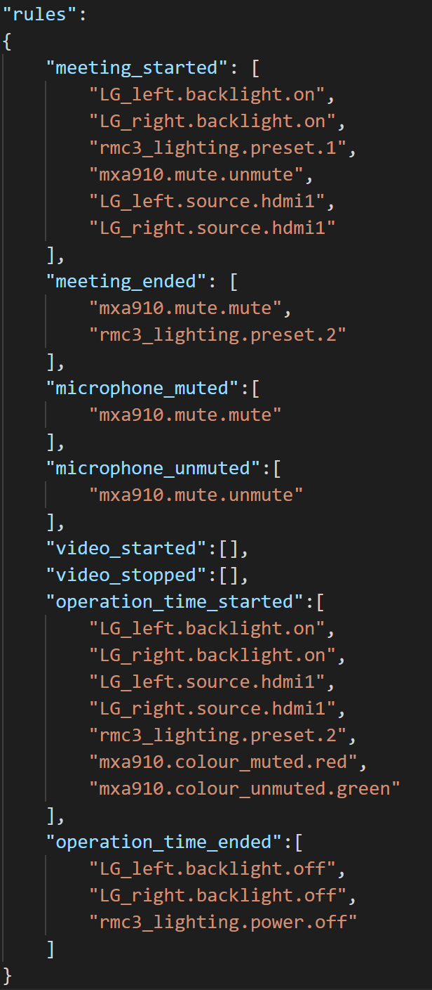
RULES
Rules define actions to be executed based off of events
Automatic and do not require the user to interact with the system
Help to maintain the experience in more complex rooms

Slide 13
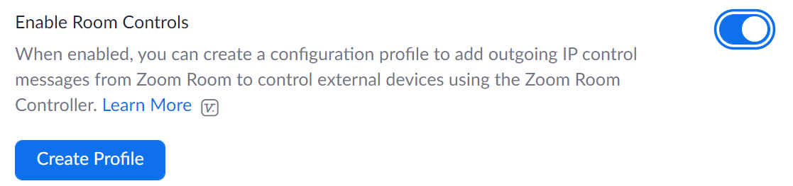
PUTTING IT ALL TOGETHER
Sign into the Zoom web portal.
Click Room Management, then select Zoom Rooms.
Click Edit to the right of the Zoom Room name.
Under Devices, toggle Enable Room Controls to on (blue).
Click Create Profile.
Enter the JSON configuration for this room.
Click Save.

Slide 14
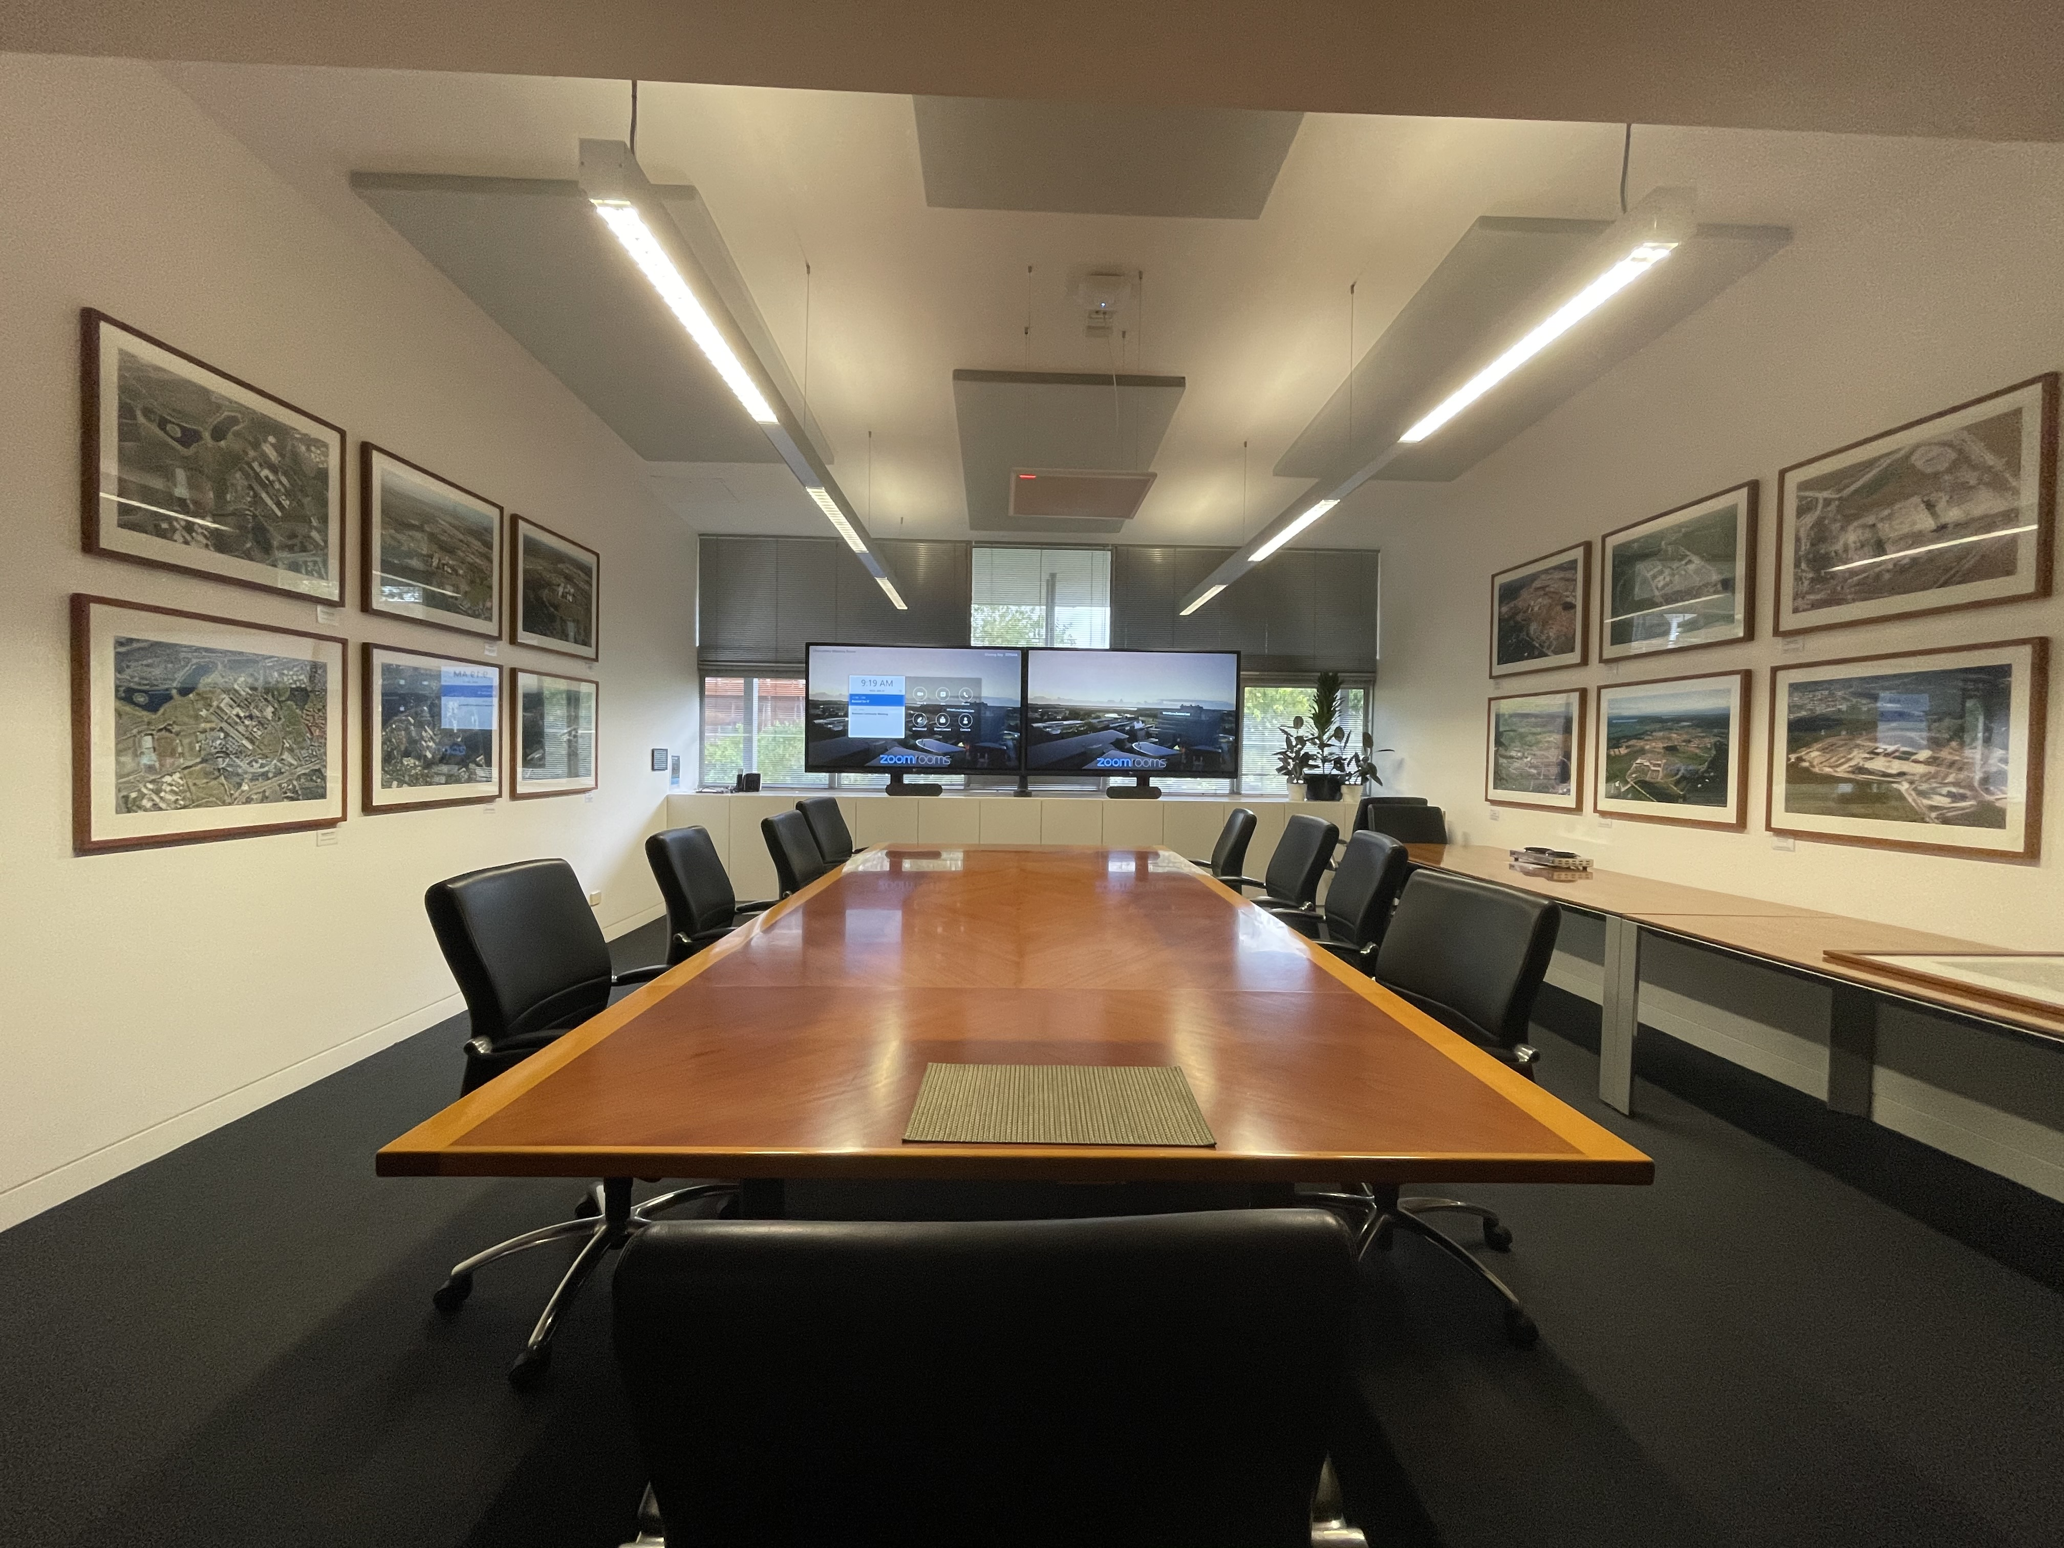
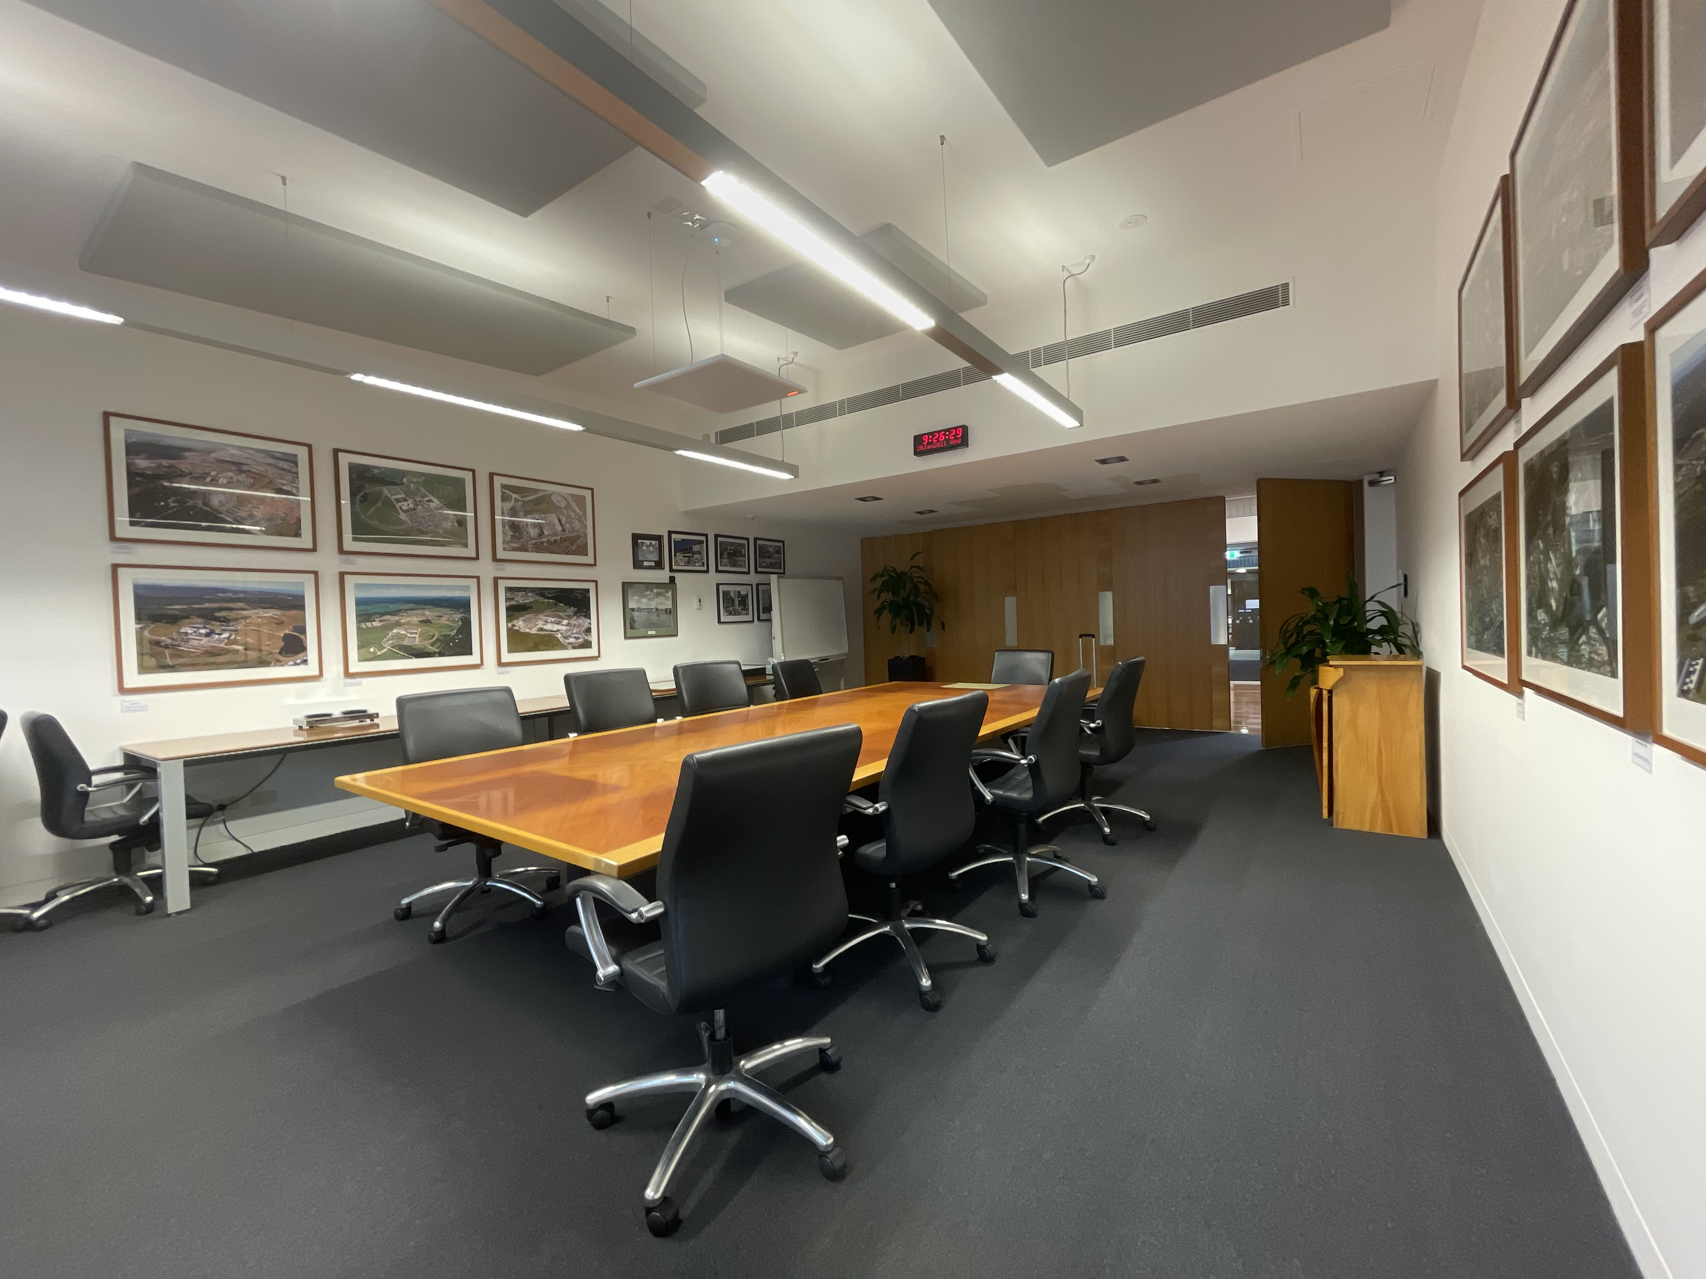
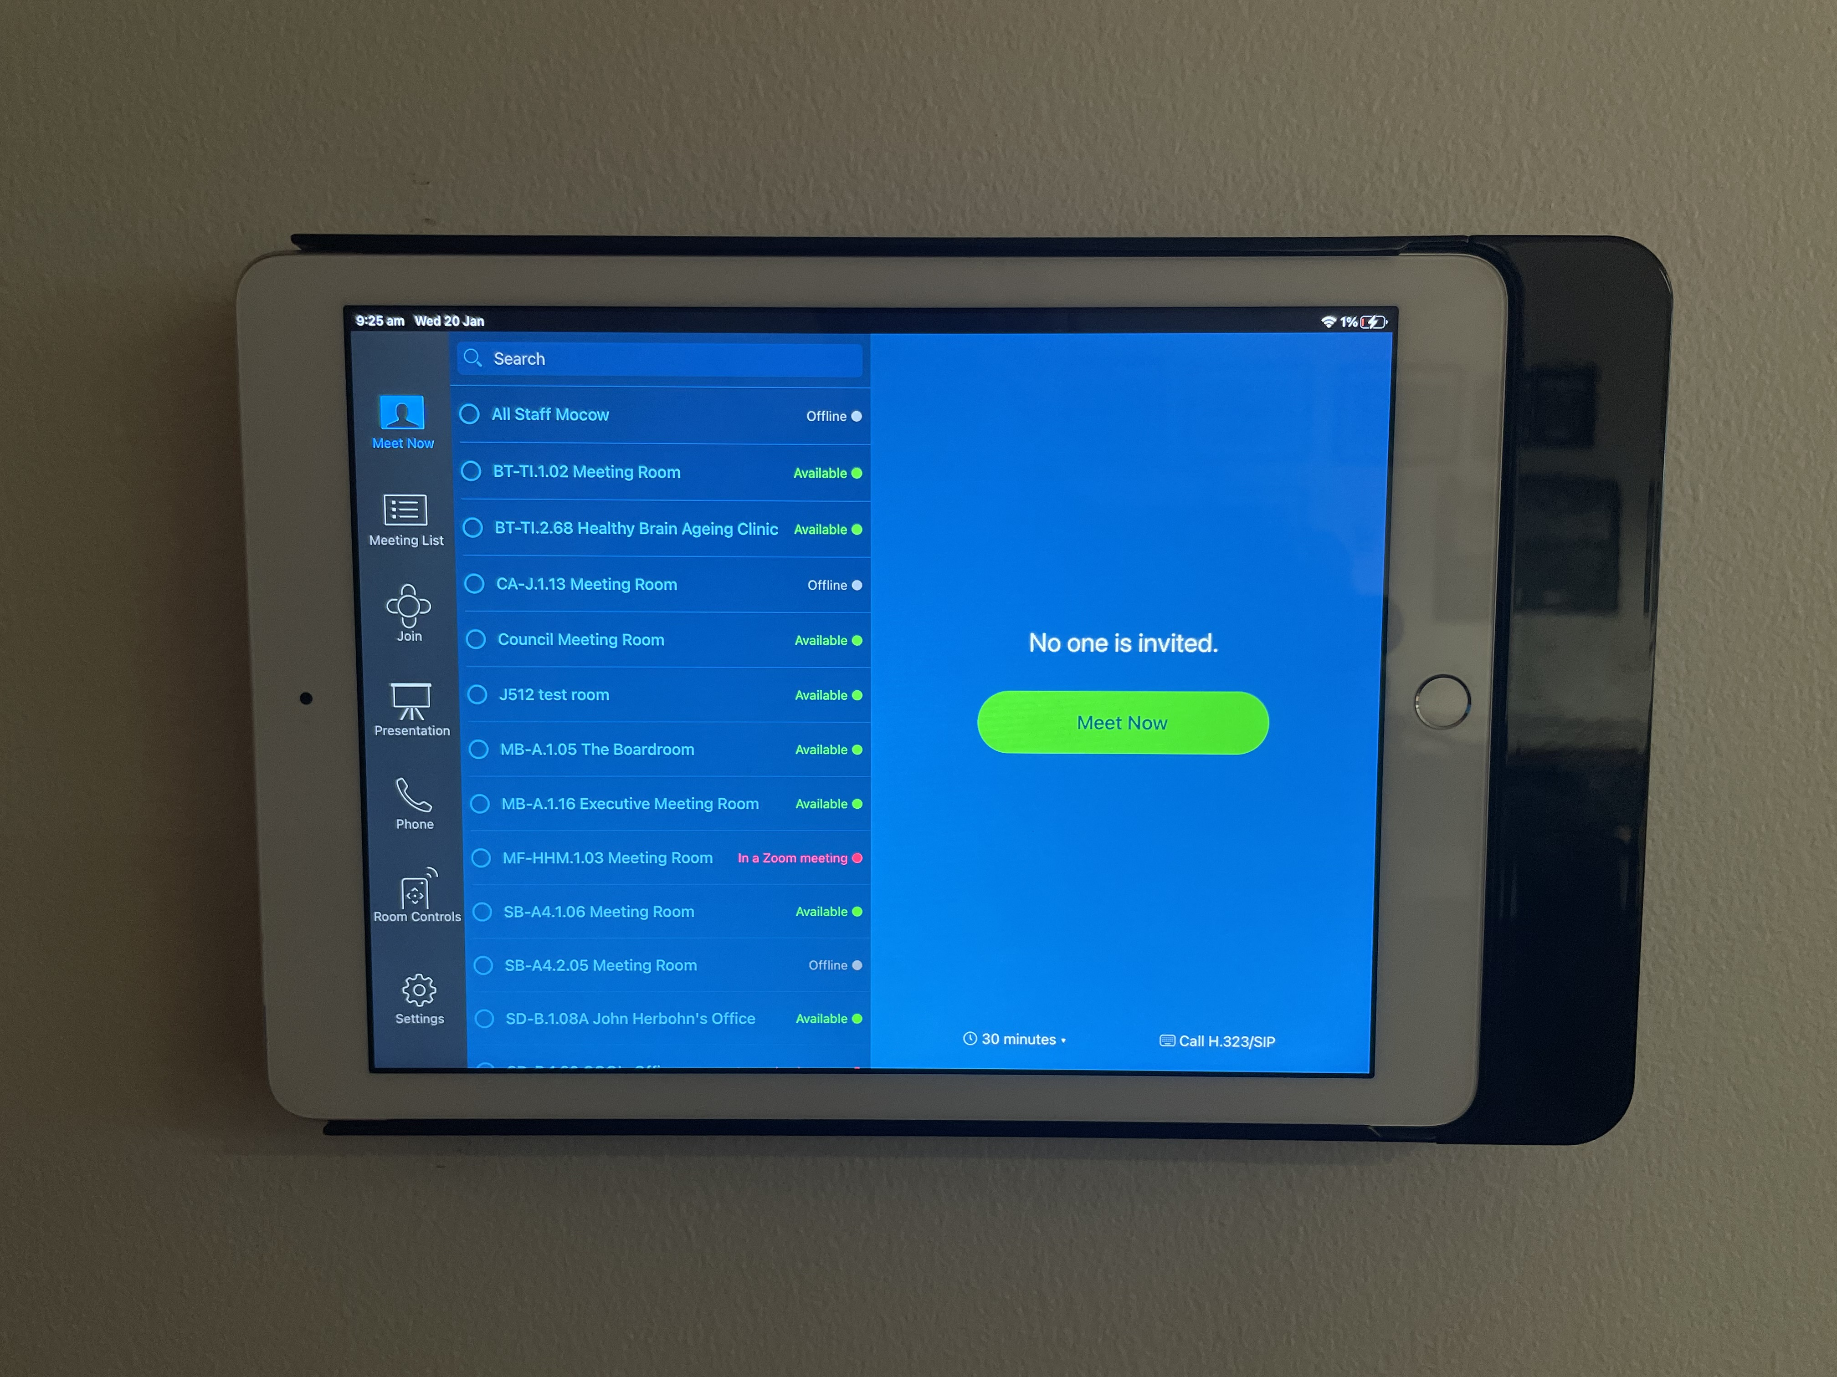
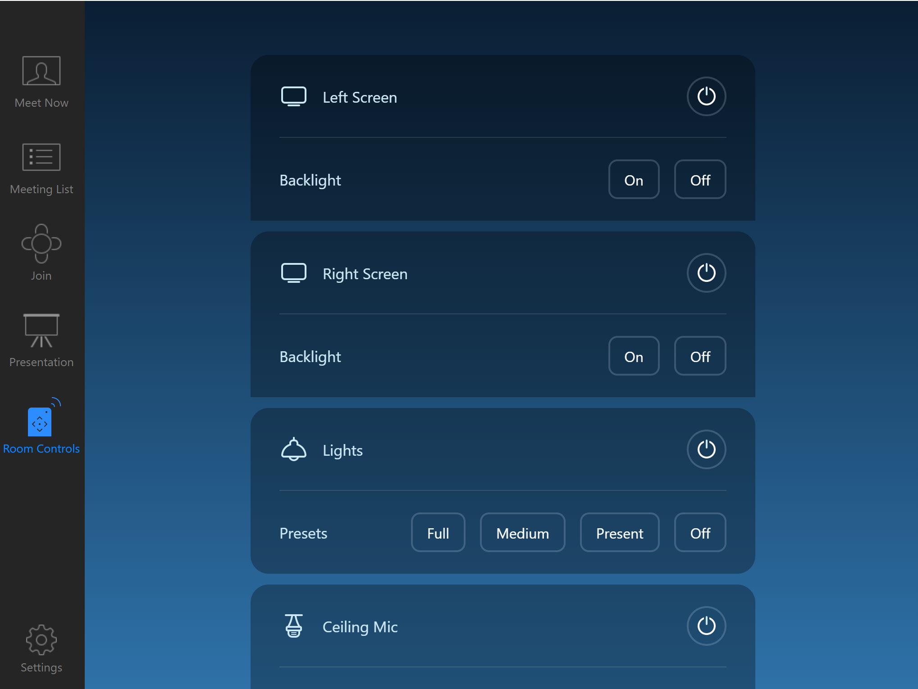
EXECUTIVE Meeting Room January 2021

Slide 15
What’s next?
Response filters – read messages coming back to the Zoom Room and trigger custom events
Control a secondary Crestron or QSC controller
Visca camera control
Revisit Executive Conference Room

Slide 16
HANDY TOOLS
https://support.zoom.us/hc/en-us/articles/360033716572 Zoom Room Control support documentation
Zoomtopia 2019 demo
Zoomtopia 2020 demo
Zenmap Network scanner used to discover open ports on a network device
VS Code Code editor with syntax highlighting for developing configuration profiles
Control Concepts Profile Maker Free to use web app for creating room profiles (easy mode)

